Slide 1
Welcome to
Mrs. Sears’ Class

Slide 2

Mrs. Sears
31st year teaching
15th year at Basha
Master’s Degree in Elementary Education
Reading Specialist
Taught 3rd, 4th, and math

Slide 3
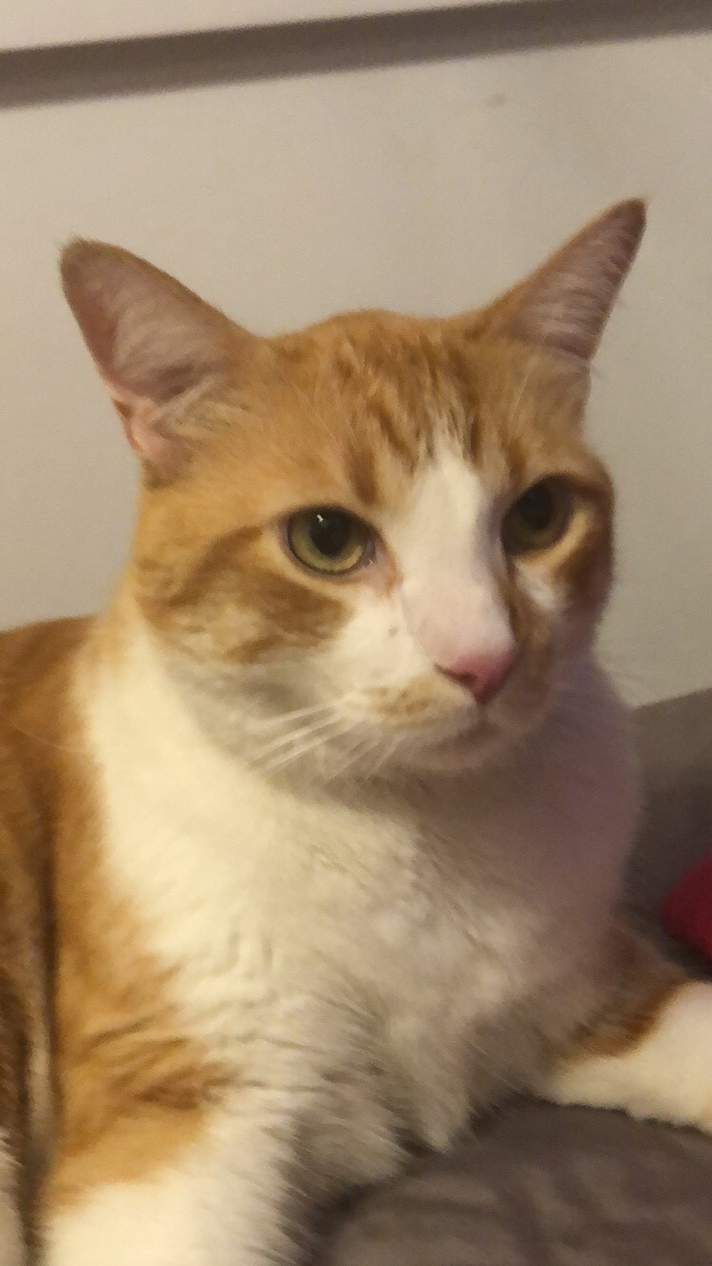
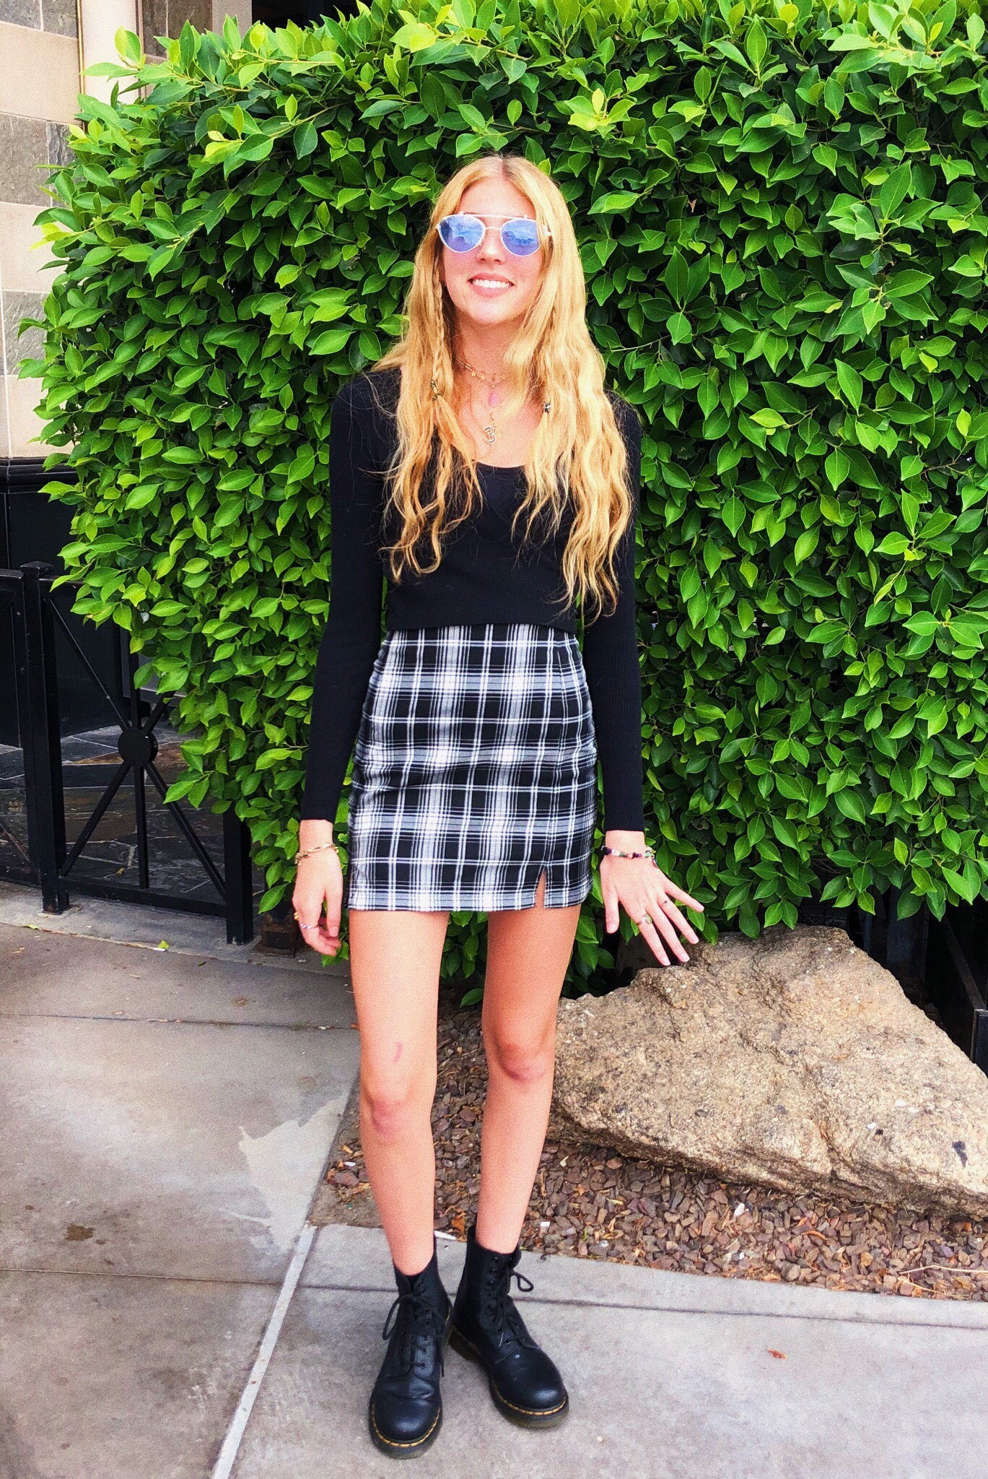
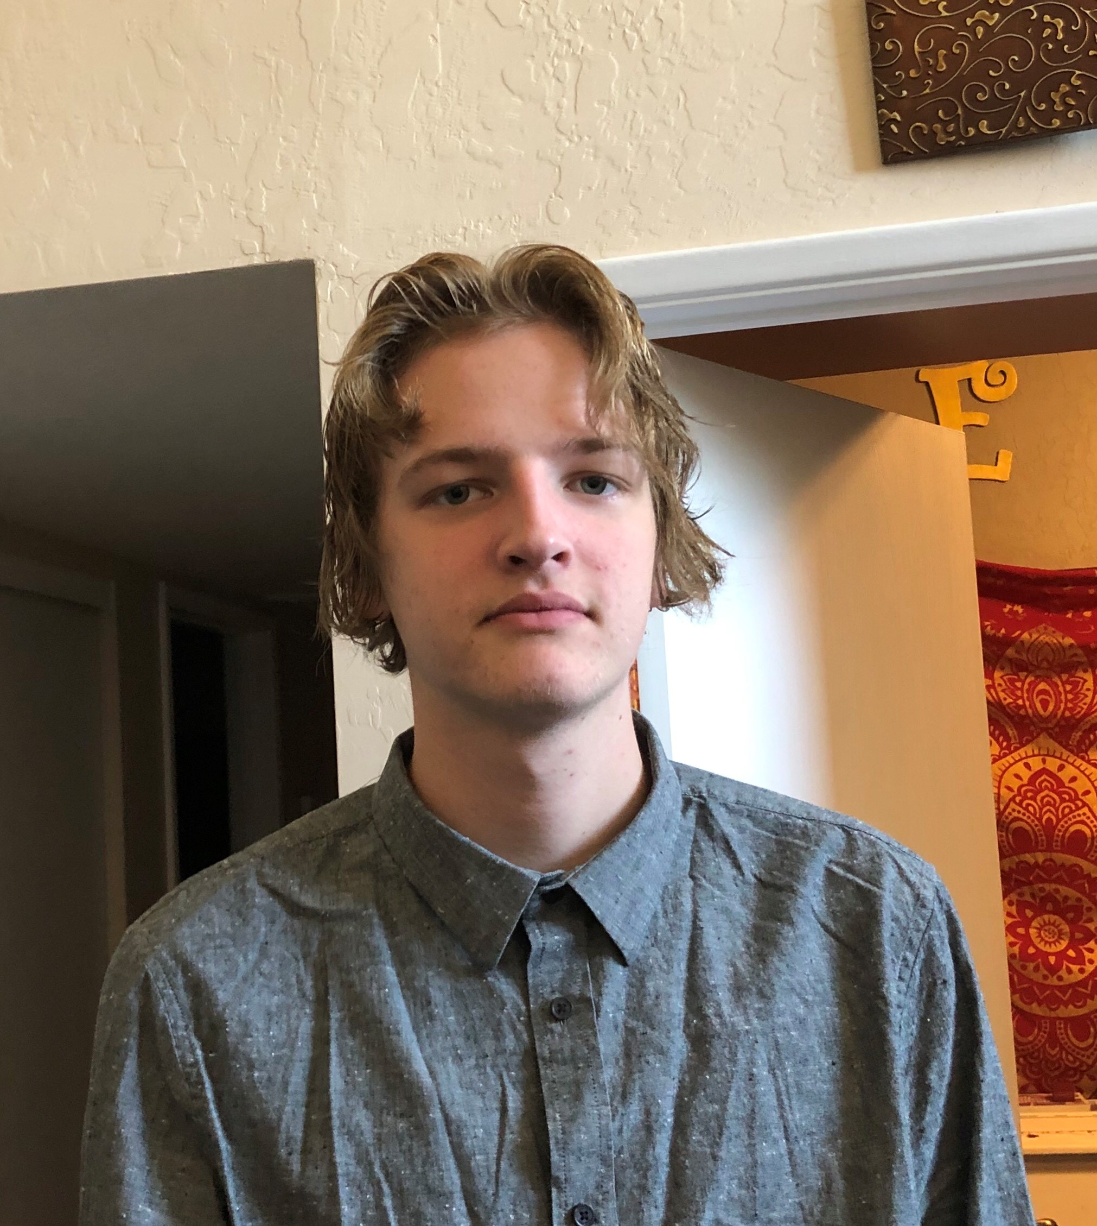
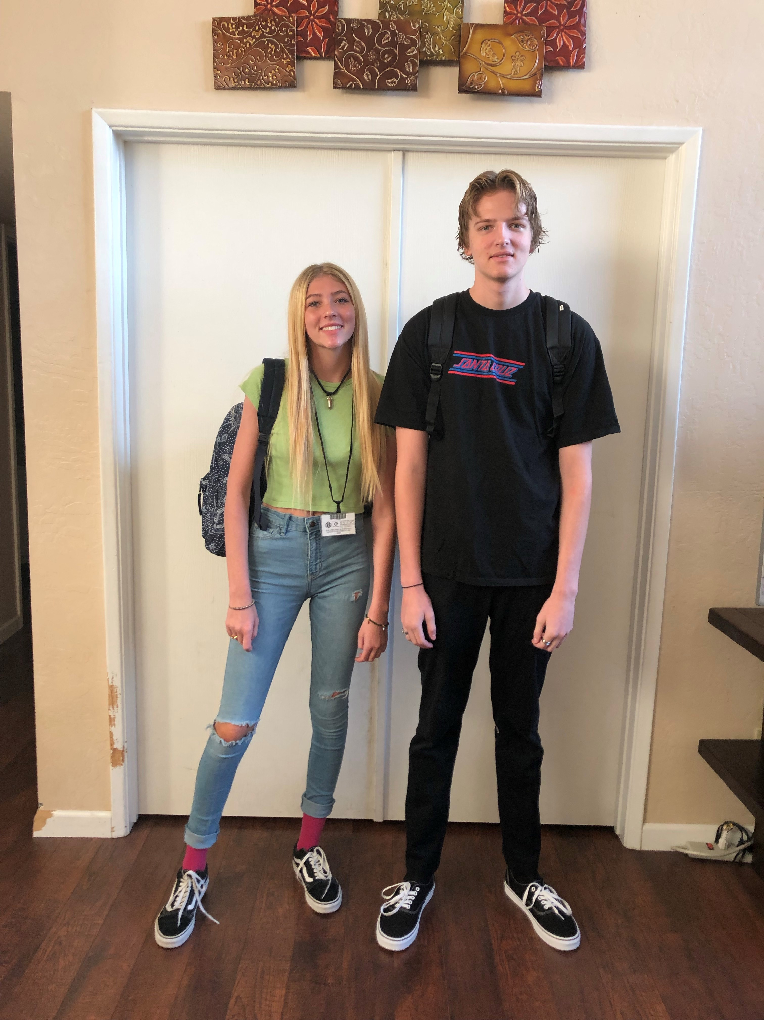
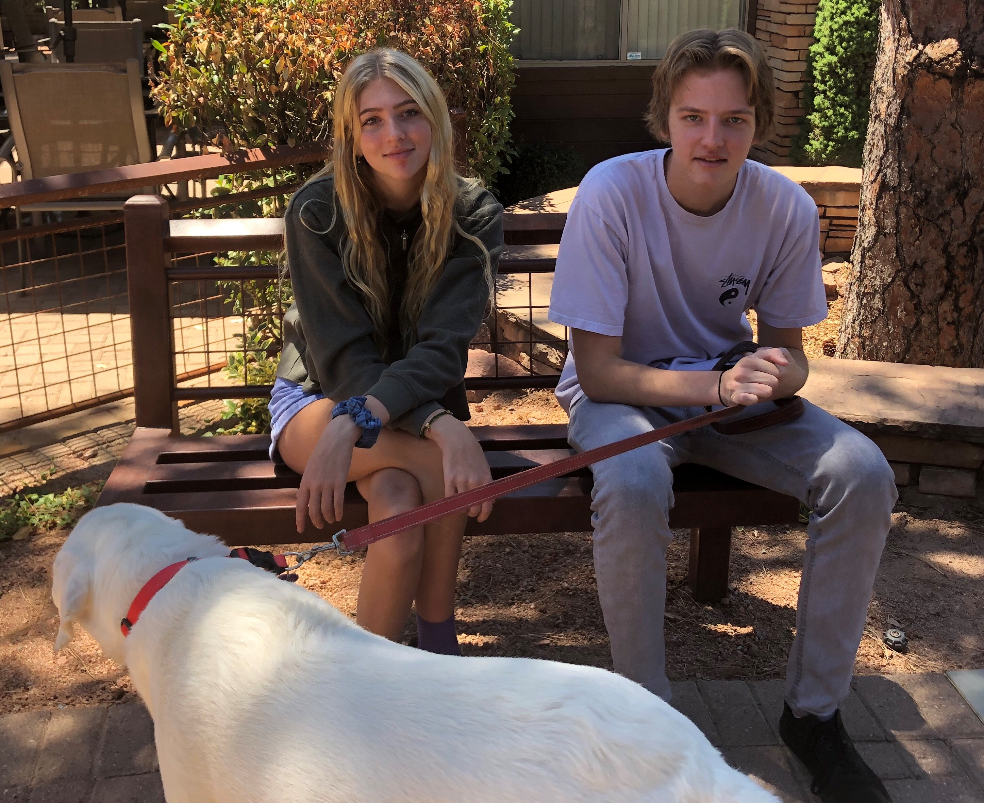
Mrs. Sears’ Family
Skamper
Emily and Ryan

Slide 4

General School Info
School Begins at 8:25
Drop Off @ 8:05 – 8:20
Dismisses at 3:00
Online- Infinite Campus:
report cards, progress reports, updates from office
School/class website
Bi-Weekly Newsletters via email

Slide 5
Lunch
Our lunch time is 11:30-12:10
Students have recess first.
11:50 is when they enter MPR to eat.

Slide 6
Curriculum Overview
Standards-based curriculum & instruction:
-Arizona College and Career Readiness Standards
Visit CUSD or the AZ Dept. of Education website to view standards
Assessment: AASA Spring State Assessment

Slide 7

ELA- English Language Arts
AZ state standards emphasize informational reading comprehension and writing skills.
Comprehension tasks require learners to identify and cite text evidence, rather than prior knowledge or experience.
Reading texts and content will be more complex.
Emphasis on developing academic & domain-specific vocabulary.
Integration of writing throughout Language Arts

Slide 8
Reading
3rd Grade HMH Into Reading Curriculum
Complex informational text (50%+)
Literature study: Genres, authors, themes, etc.
Reading skill exercises
Vocabulary study & tests
Oral reading to develop fluency
Sustained silent reading (D.E.A.R)
Literature read-aloud
Book quizzes, lesson tests, unit tests
Comprehension tests

Slide 9
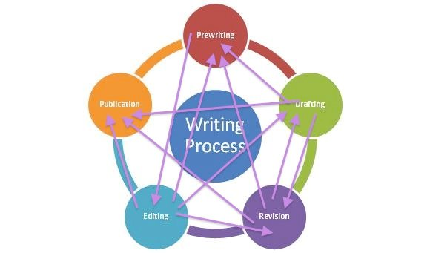

Writing
Drawing evidence from literary and informational texts to support analysis, reflection, and research
Writing opinion pieces on topics or texts supporting a point of view with reasons supported by facts/evidence and details
Writing to inform or explain, using precise language and developing the topic using various methods (e.g., facts, definitions, quotations)
Writing narratives for real or imagined experiences or events using details that precisely convey experiences and events
Using a Writing Process that includes planning, revising, and editing
Conducting short research projects using print and digital sources to build knowledge
Thinking Maps for planning
Conventions – Capitalization, punctuation, spelling, organization

Slide 10
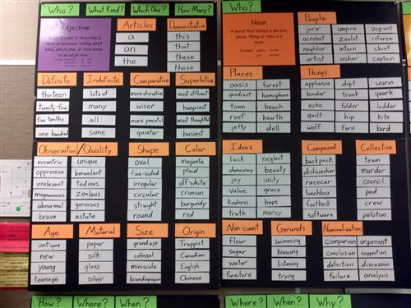


Language
Standard English grammar and usage when writing and speaking
Grade-level appropriate Standard English rules for capitalization, punctuation, and spelling to communicate effectively
Selecting language, words, grammar, and punctuation appropriate for the purpose, audience, and effect desired
Using multiple strategies to determine or clarify the meaning of unknown words (vocabulary)
Demonstrating understanding of figurative language, word relationships, and shades of meaning to use vocabulary purposefully and precisely
Using strategies including language structure, word origin, and textual clues to build vocabulary and enhance
Acquiring and purposefully and precisely using grade-appropriate vocabulary

Slide 11

Mathematics
Go Math lessons & assessments
Focus on building concepts w/ visual representations
Procedural skill and fluency (computation)
Rigor and progression of lessons leads to deeper conceptual understanding.
Developing students’ ability to access/apply concepts and computation to solving problems
Mathematical Practices (e.g. precision, persistence)
Class participation & collaboration (“Explain your thinking”)
Math Practice, quizzes & unit tests
Think Central for extra work/ videos

Slide 12
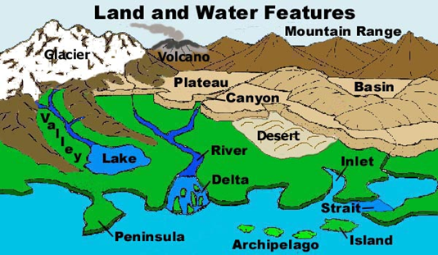


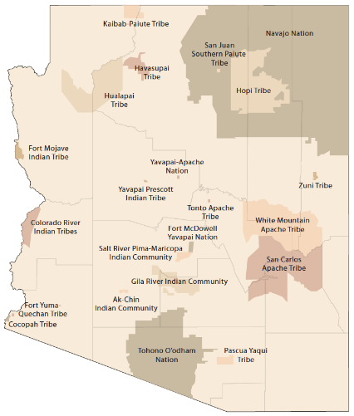
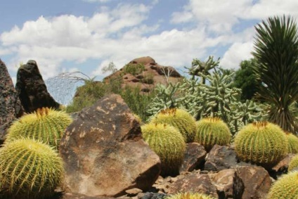
Social Science
We will learn about Arizona this year.
industries and occupations that have shaped Arizona
resources that affect decision making in AZ (water and other natural resources)
Arizona is connected to other places like New Mexico and other nations by the movement of people and goods
making maps of Arizona (past and present)
places in AZ (Grand Canyon, Mogollon Rim, Colorado River, Salt River, Gila River, Hoover Dam, Roosevelt Dam, state capitol)
22 tribes in Arizona
plants and animals in Arizona
Cultures civilizations and innovations
Explorers, settlers, trappers, missionaries, colonizers
We will also complete STEM Projects.

Slide 13

Speaking and Listening
DAILY ACTIVE PARTICIPATION in discussions with small groups, and whole class:
Listening to classmates
Asking questions to clarify
Responding to questions
Paraphrasing information
Speaking clearly
Speaking in complete sentences when appropriate
FORMAL PRESENTATIONS
Conveying ideas and information clearly and persuasively
Presenting knowledge and ideas using visual displays
Presenting information, with appropriate pacing, using formal or informal language appropriately

Slide 14

Grades
Parent Portal on Infinite Campus
Use of learning goals and scales
Participation points
Progress reports and report cards will be available only online unless paper copy requested
Report card grades according to district standards: (Percent scores instead of letter grades on report cards)
Consistently outstanding work (90-100%) = “A”
Consistently above average (80-89%)= “B”
Consistently satisfactory work (70-79%) = “C”
Consistently below standard (60-69%)= “D”

Slide 15

Character Education
Pride in the P.A.C.K.
  Positive
  Achieving
  Compassionate
  Kids
  These traits are tied into our daily behavior.

Slide 16
Pride in the P.A.C.K.
Good Behavior-Class Agreement
Behavior Bucks/Monthly Store
P.A.C.K. Awards
“E” Indicators on Report Cards
P.A.C.K. Time

Slide 17
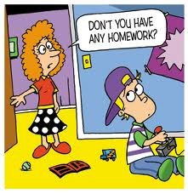
Homework
Reading-20 minutes daily
Any unfinished classwork

Slide 18
Odds and Ends

Slide 19

Star of the Week
During the week that your child is Student of the Week please help your child prepare a poster describing your child. You can use pictures or drawings depicting events from your child’s life. Baby pictures, vacation photos, school pictures, special events, can all be included on the poster.
Optional but not required: Students can bring a stuffed animal the week they are star student.

Slide 20
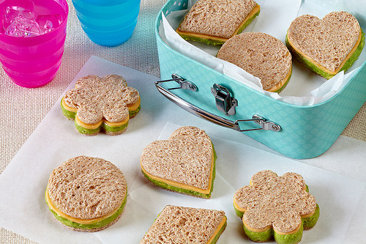

Snacks
Snacks are optional. Each child brings their own snacks.
Snacks will not be shared.
Students may bring two snacks.

Slide 21

Friday is Spirit Day!
Wear your Basha Bobcat shirt!
Or, you may wear Basha colored clothes (navy blue and tan) to show your spirit.

Slide 22

Field Trip Information
  Field Trips- Tax Credit Donation. In order to have these learning experiences we are encouraging tax credit donations be made to 3rd grade. We can’t do it without you!
    $400 per couple, $200 single
  Field Trip fees will be paid on Infinite Campus

Slide 23
Need to Reach Me?
480-883-4410
Sears.daryl@cusd80.com (best way to reach me)
I usually send my weekly newsletter by e-mail on Friday.
You can also find it on my website located on the Basha Elementary School website.

